Slide 1







Spanish Restaurant Management System

Slide 2








Topics
Topic 1: Problem Statement
Topic 2: Problem Analysis

Slide 3
Topics
Topic 3: Stakeholders
Topic 4: System Boundaries

Slide 4
Topics
Topic 5: System Constraints
Topic 6: Functional Requirements

Slide 5
Topics
Topic 7: Non-Functional Requirements
Topic 8: Diagrams

Slide 6




1
Problem Statement
The restaurant’s problem is handling customers and managing employees manually or by using old, ineffective system. It costs money, effort & time. Decrease in customer satisfaction and in tracking employees effectively. Our system is intended to assist customers to choose & order their preferred Spanish meal, assist the kitchen staff to track customers’ orders fast and in-order, assist the owner to monitor his restaurant accurately.

Slide 7



2
Problem Analysis
1
4
Culture Differentiation
Inventory Wastage
2
5
Customer Retention
Improper Branch Management
6
Improper Payroll Management
Improper Supplier Management

Slide 8

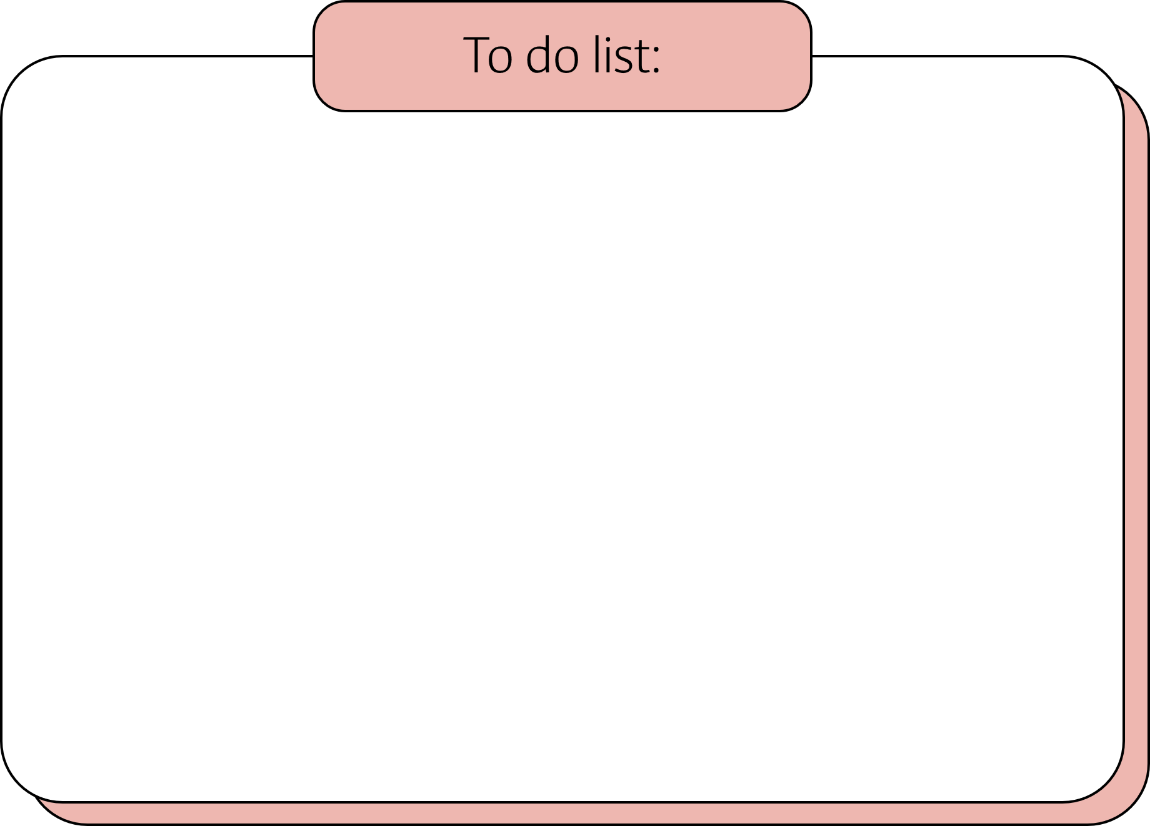
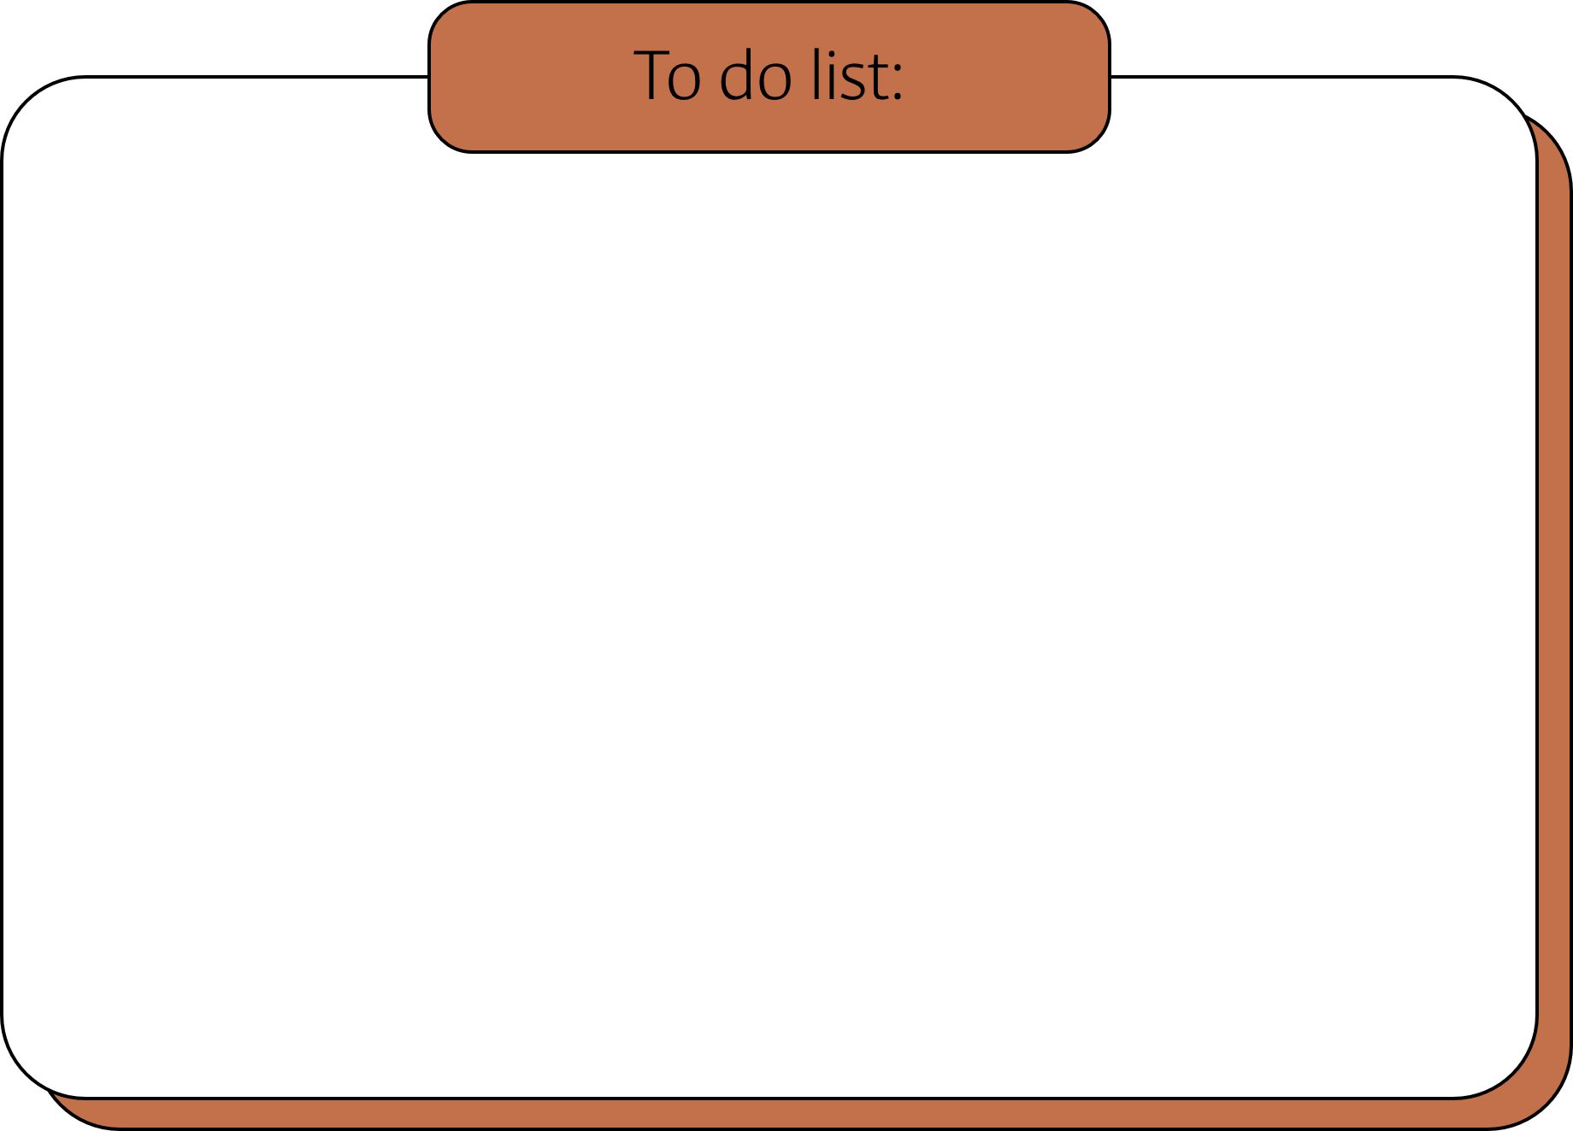



Culture Differentiation
Result
Affect
Customers
Customer may not like Spanish food
System Benefits
Increase customer awareness about the Spanish food, its origins, ingredients, …etc.

Slide 9



Customer Retention
Result
Affect
Complexity of identifying customer needs, problems, or dissatisfactions.
Customers
System Benefits
Identify customer needs easily through constant feedbacks after his/her experience in the restaurant.

Slide 10


Improper Payroll Management
Result
Affect
On certain occasions like (festivals, weekends, shortage of staff, overtime work) there are plenty of errors in such complex situations leading to employee dissatisfaction
Employees
System Benefits
With the system it will be easy for the staff to customize their availability & schedule

Slide 11



Inventory Wastage
Affect
Result
Ingredient costs are a restaurant's most significant expenses, and managing inventory accurately can be difficult. Without correct information, inventory management, location of goods, the expiration date of ingredients, businesses, receiving date, etc. is hard to be tracked
Owner
System Benefits
The system covers the inventory process from end to end, from counting and transferring to invoicing and ordering.

Slide 12



Improper Branch Management
Result
Affect
Many franchise restaurants have multiple warehouses in different locations. Often, these branches are not in sync with each other which causes lack of alignment and coordination
Owner
System Benefits
With a reliable multi-warehouse management system, all branches can be managed and synced together easily & efficiently

Slide 13

Improper Supplier Management
Result
Affect
Time wasted for late delivery
More expenses from expensive suppliers
Low quality or expired supplies
Owner
Supplier
System Benefits
The system keeps track on reliable suppliers, supplies, the best pricing, and on-time delivery

Slide 14






3
Stakeholders
Owner
Supplier
Admin
Spanish Chef
Customer
Waiter
Cashier

Slide 15

4.
System Boundaries
Admin
Has all privileges
Can create, add, delete, update information for any profile (customer, waiter, manager, owner, chef, cashier)
Responsible for any maintenance required to the system
Customer
Can add, edit, update or delete information from his/her own profile only
Can make/delete an order
Can pay online

Slide 16
System Boundaries
Waiter
Record customer order into the system
Mark for finished orders when delivered in the system
Receive payments from customers and record it into the system
Receive customer complaint and record it into the system

Slide 17
System Boundaries
Cashier
Accept payments for customer orders and record it into the system
Spanish Chef
Cook orders that have been recorded inside the system

Slide 18
System Boundaries
Owner
View restaurant statistics (profit %, loss %, sales %, …etc)
Supplier
Can access/view the restaurant's inventory to see if there is a shortage of a specific item, which will be immediately sent to the restaurant

Slide 19
System Boundaries
The system is not stand-alone. It is integrated with 12 other systems synced together for alignment, collaboration and efficiency like (Menu Management System + Online ordering System + Inventory Management System + Payroll Management System + Supplier Management System + Payment System + Kitchen Management System + Table Management System + POS System + Accounting System + Reservation Management System + Customer Service System) all in one.

Slide 20

Functional Requirements
El camarero
Waiter
Greeting Customers “Hola Señor/Señora”
Take customer orders “Cómo puedo ayudarte?”
Send customer orders to the kitchen staff
Deliver the orders from the kitchen to the customers “Buen Provecho”
Receive customer feedbacks (if any) “(-)Lo sientimos mucho/(+)Muchas Gracias”
Farewelling Customers “Adiós Señor/Señora”

Slide 21
Functional Requirements
El cliente
Customer
Place an order with the specific item name and quantity through the provided menu
Receive his/her order
Check for offers & promotions
Pay for the meal
Provide feedback

Slide 22
Functional Requirements
El cocinero
Spanish Chef
Cook meals in a timely manner
Arrange meals to be served by the waiter

Slide 23
Functional Requirements
El cajero
Cashier
Handle customer orders
Receive payments
Give receipts to the customers

Slide 24
Functional Requirements
El Dueño
Owner
Manages the entire restaurant
View Reports
Manage all branches (if any)
Hire/fire employees
Responsible for any renovations, upgrades or maintenance in the restaurant
Pay for any bills, taxes, expenses, etc.

Slide 25

Functional Requirements
El administrador
Admin
Manage the users involved in the system
Insert/Delete users on the system
Control the whole system
Maintain the system

Slide 26


5
System Constraints
Available physical space and seating capacity limits how many customers the restaurant can serve at any given time.
The number of kitchen staff and cooking equipment limits how many orders can be fulfilled simultaneously.

Slide 27
System Constraints
The availability of fresh ingredients limits the types of dishes that can be prepared on any given day.
The restaurant's location and accessibility affect the number of customers that can be served.

Slide 28
System Constraints
The restaurant's operating hours limit the time period during which orders can be accepted.
The restaurant's budget constrains the number of staff that can be hired or the quality of ingredients that can be used.

Slide 29
System Constraints
Health and safety regulations limit the types of cooking techniques and equipment that can be used.
The restaurant's technology infrastructure constrains the type and speed of online orders that can be accepted.

Slide 30
System Constraints
Customer preferences and dietary requirements constrain the types of menu items that can be offered.

Slide 31
6
Functional
Requirements

Slide 32
Functional Requirements
Menu Management
The restaurant should have a system to manage the menu so that the availability of dishes, ingredients, and prices can be updated and viewed regularly

Slide 33
Functional Requirements
Online Ordering System
The restaurant should provide an online ordering system which should include options for payment, order status tracking, and an easy way to cancel orders

Slide 34
Functional Requirements
Reservations Management
The restaurant should have a system to manage reservations so that customers can book tables in advance

Slide 35
Functional Requirements
Table Management
The restaurant should have a table management system to keep track of which tables are occupied, reserved, or available

Slide 36
Functional Requirements
Payment System
The restaurant should have a payment system that is easy to use, efficient, and integrates with the online ordering system

Slide 37
Functional Requirements
Inventory management
The restaurant should have an inventory management system to keep track of the ingredients, supplies, and equipment required to operate the restaurant

Slide 38
Functional Requirements
POS System
The restaurant should have a Point of Sale system that can be used to record sales transactions, generate bills, and process payments

Slide 39
Functional Requirements
Kitchen Management
The restaurant should have a system to manage the kitchen operations by tracking orders, coordinating with staff, and monitoring the preparation and delivery of dishes

Slide 40
Functional Requirements
Customer Service
The restaurant should prioritize customer service by providing an efficient system for addressing customer complaints, feedback, and suggestions

Slide 41

Functional Requirements
Accounting System
The restaurant should have a system to manage financial transactions, including revenue generation, expenses, and tax filings

Slide 42
7
Non-Functional Requirements

Slide 43
Non-Functional Requirements
Usability: The system should provide an interactive user-friendly interface that is easily understandable for all users.
Security: The system should have firewalls to prevent unauthorized access to sensitive data.
Performance: The system should be able to handle a large number of orders during peak hours.

Slide 44
Non-Functional Requirements
Availability: The system should be available 24 hours except for the booking service that will be available at 2 hours before the opening hour of the restaurant until midnight.
Speed: The system should have a response time of less than 0.5 seconds for most transactions.
Maintainability: The system should be easy to maintain and update. The system should update the booking information in real-time.

Slide 45
8
Diagrams

Slide 46
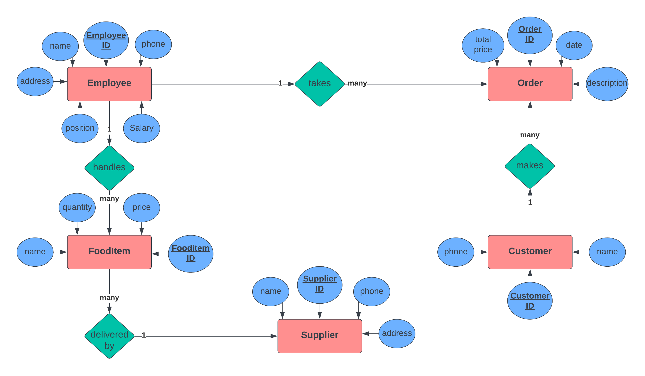
ERD

Slide 47
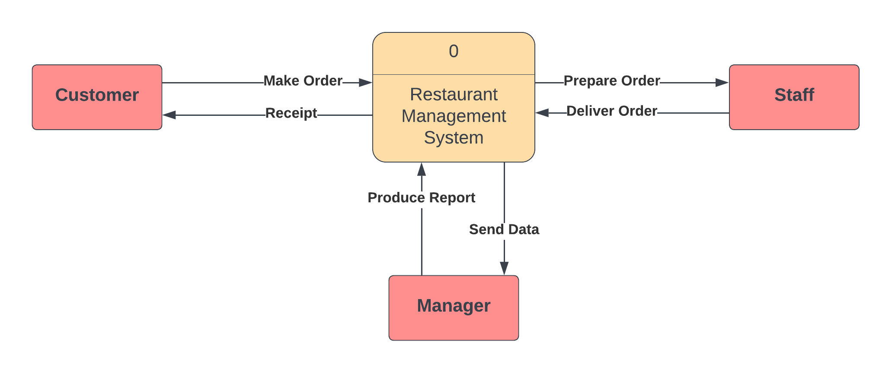
DFD
Context Level

Slide 48
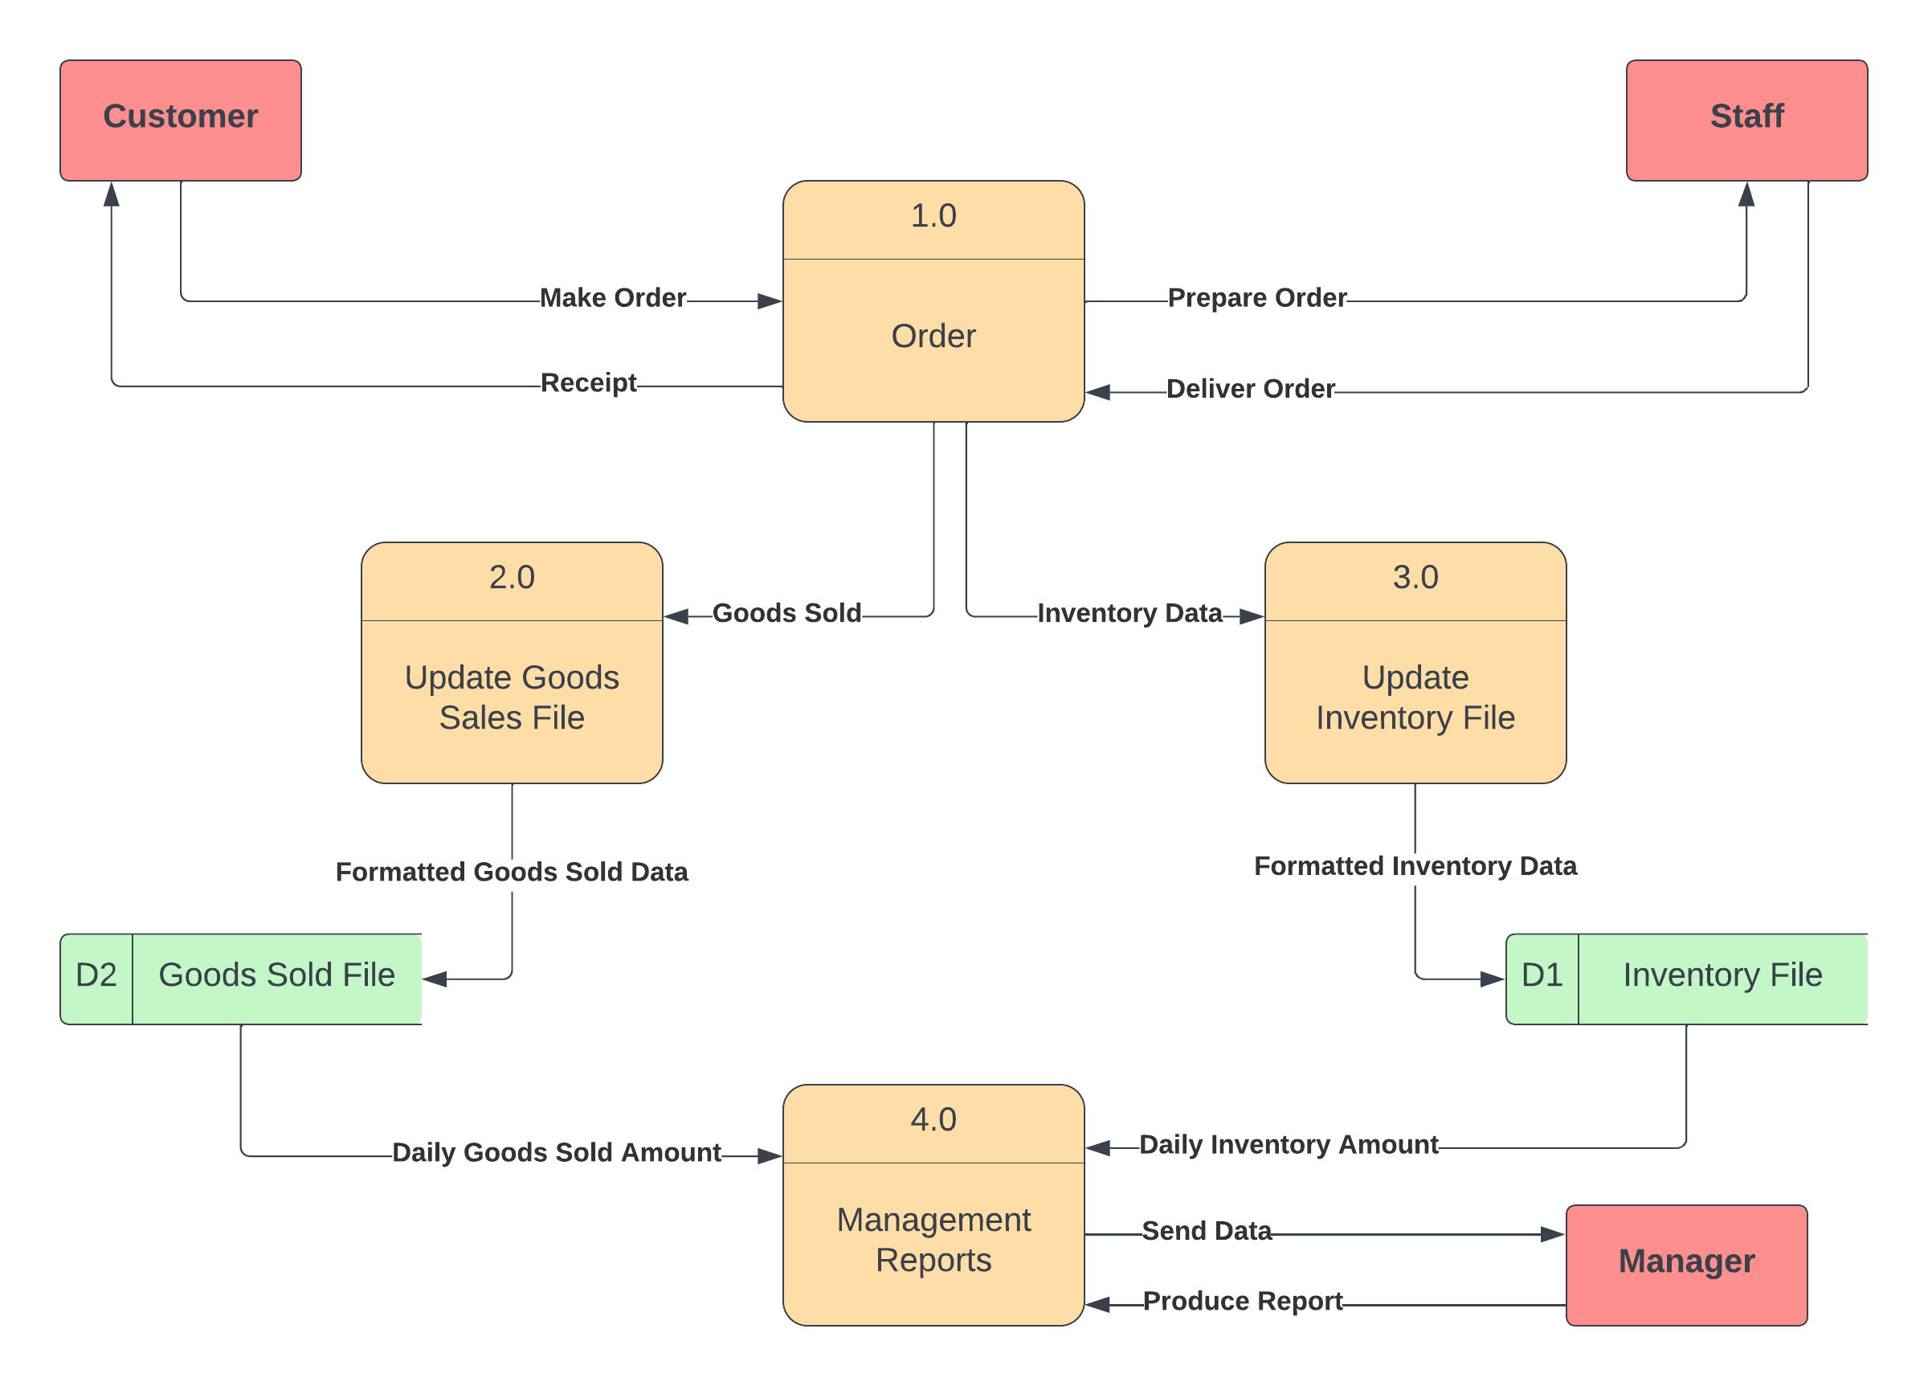
DFD
Level 0

Slide 49
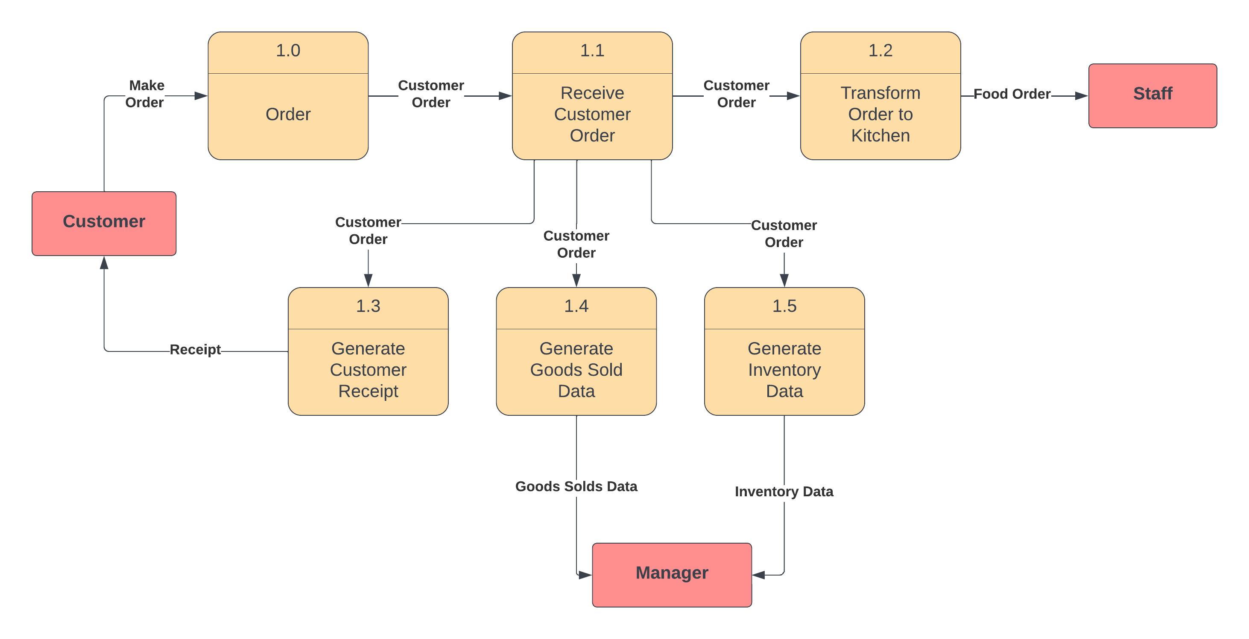
DFD
Level 1

Slide 50
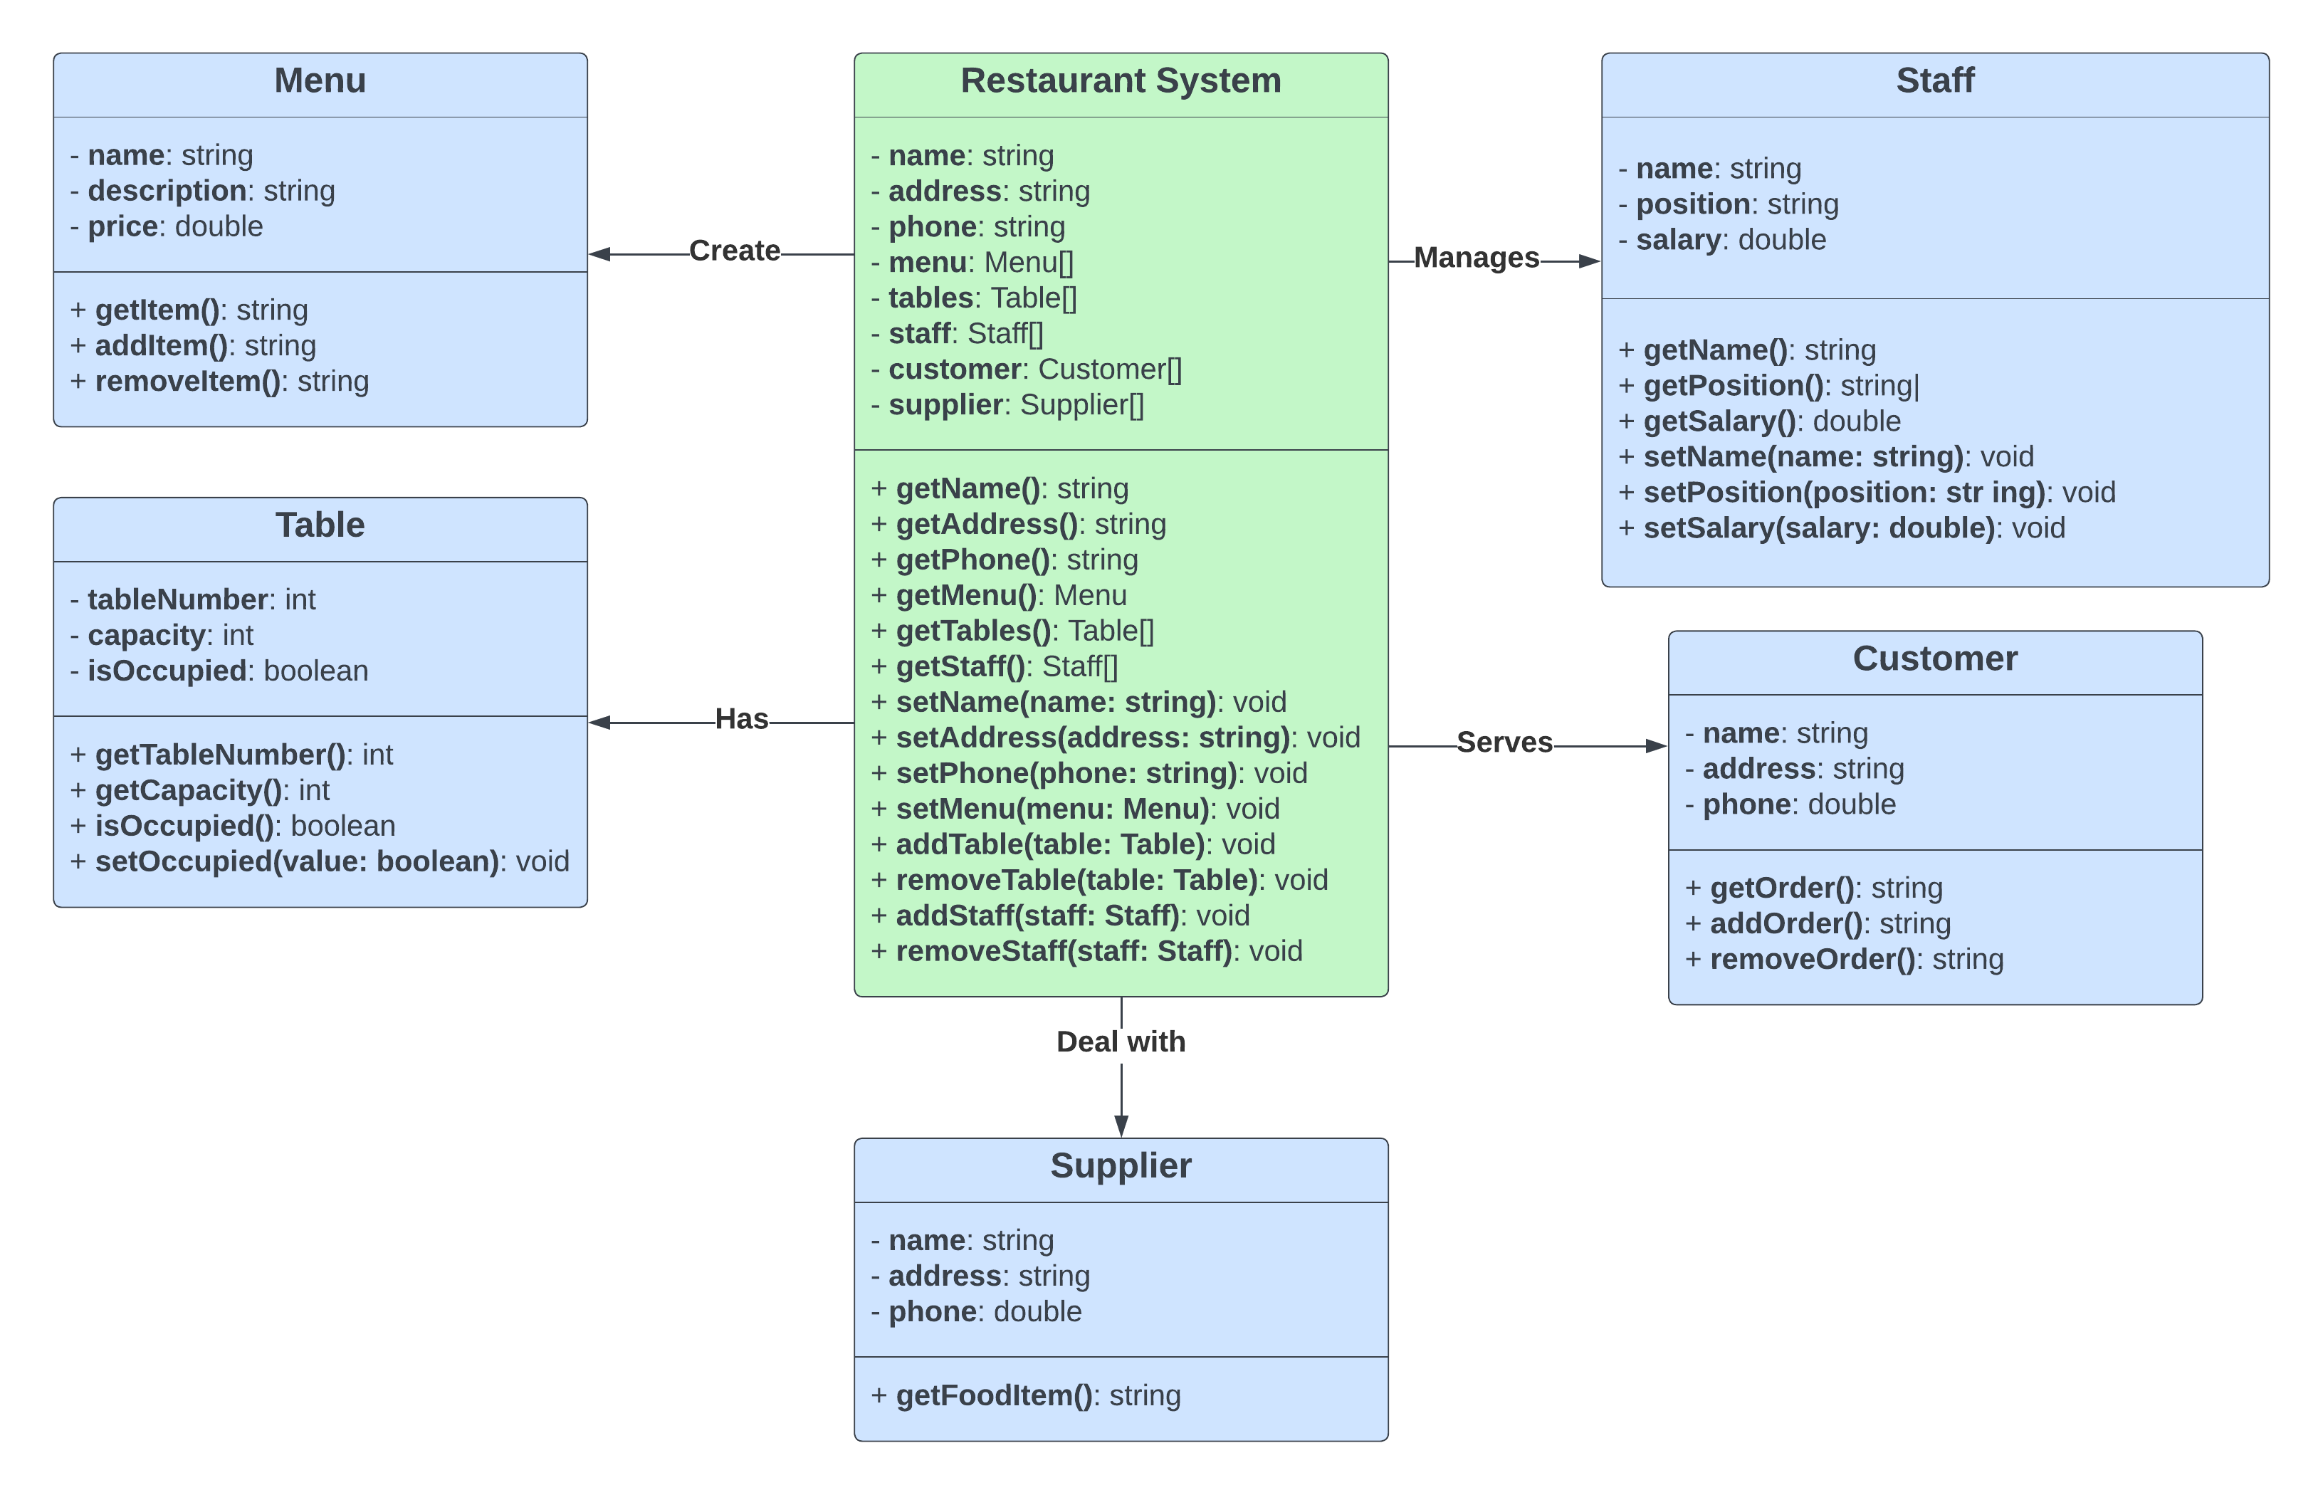
Class Diagram

Slide 51

Sequence Diagram

Slide 52
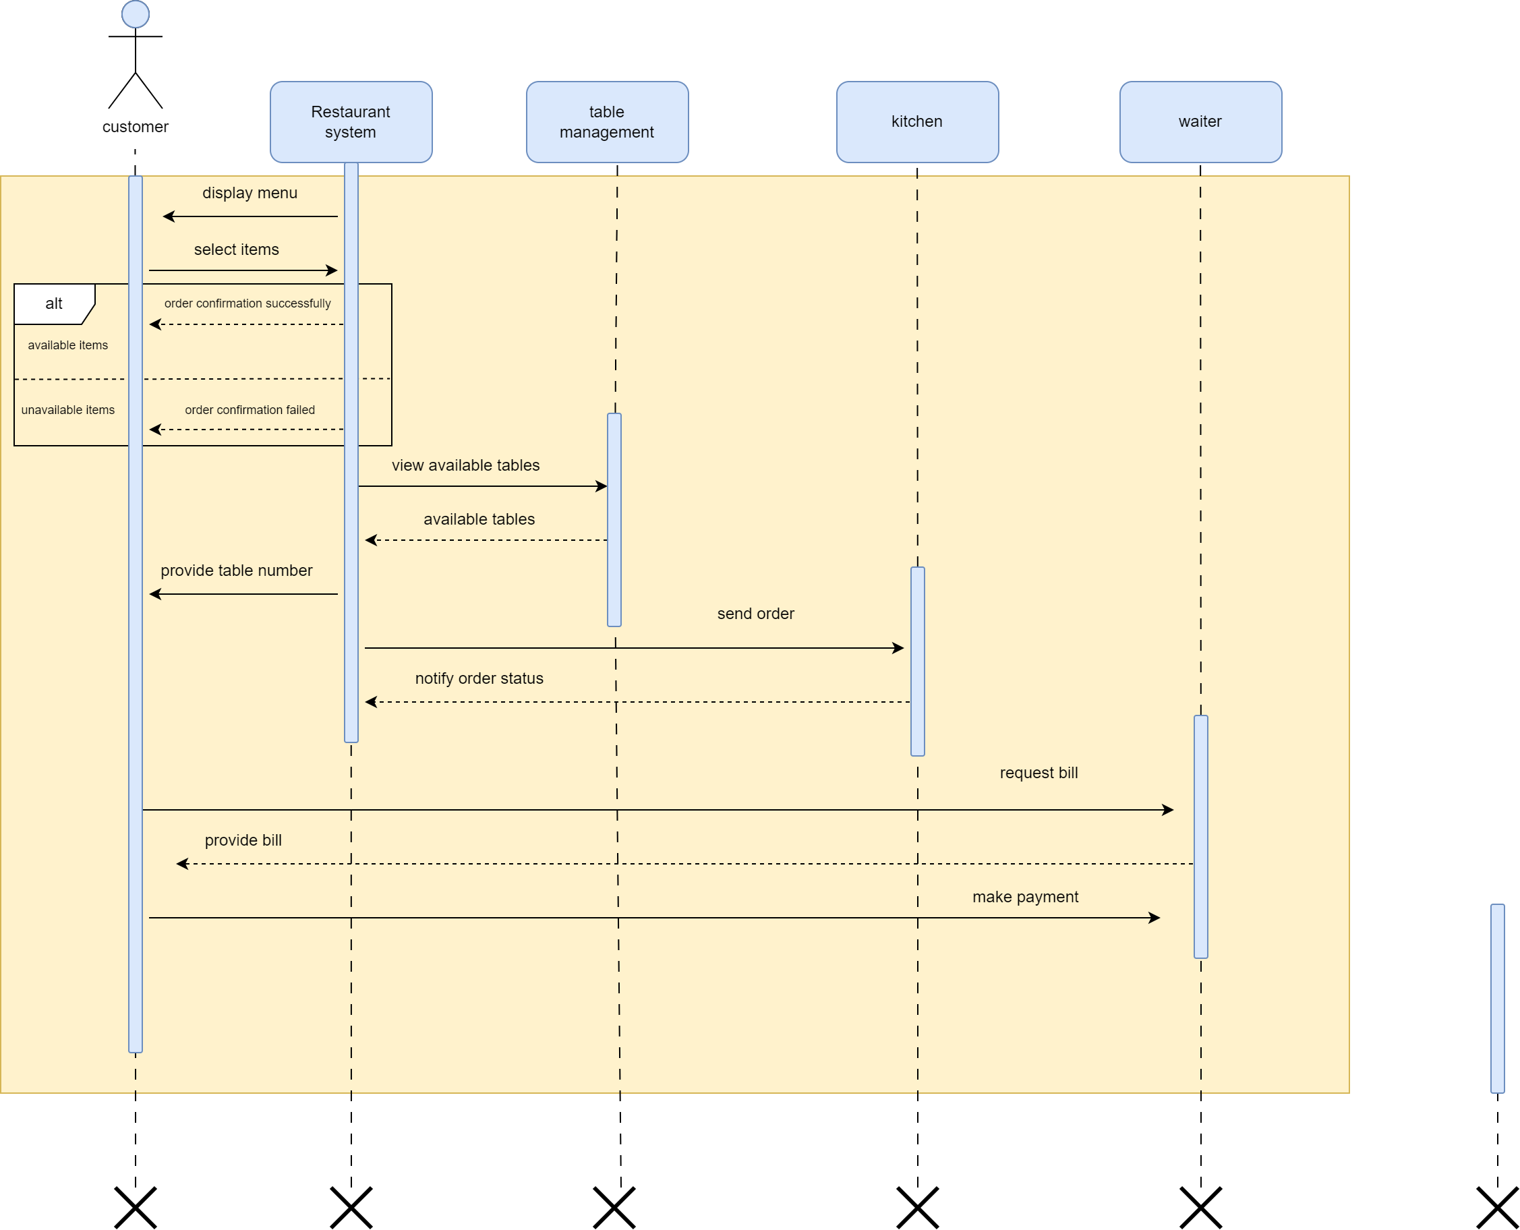
1. Customer

Slide 53
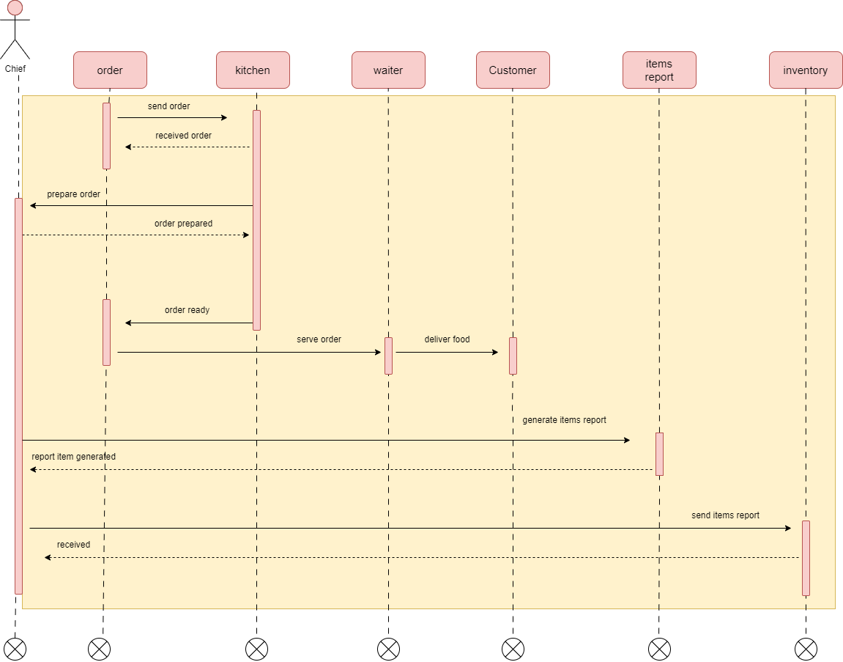
2. Chef

Slide 54
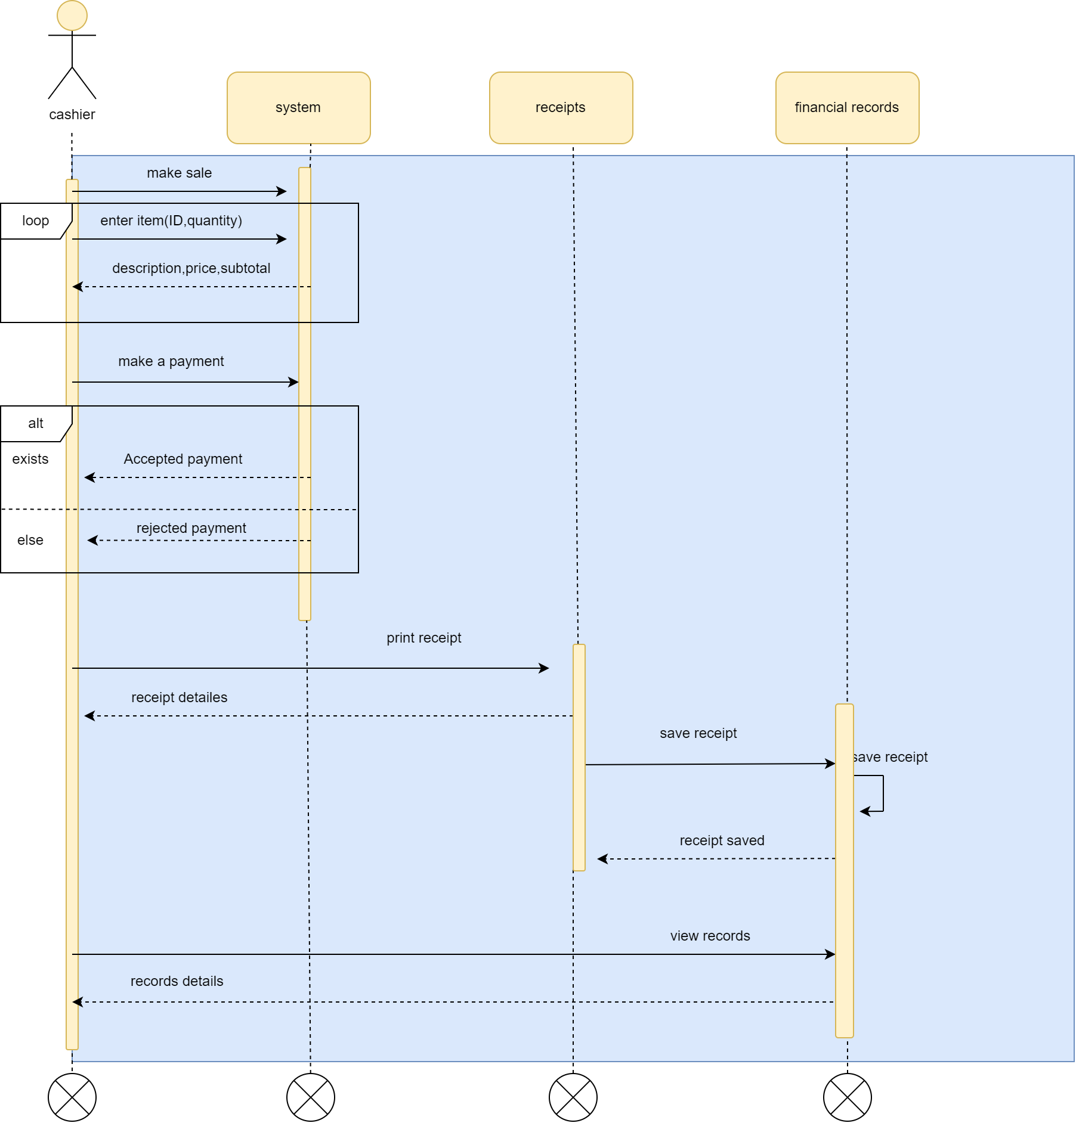
3. Cashier

Slide 55
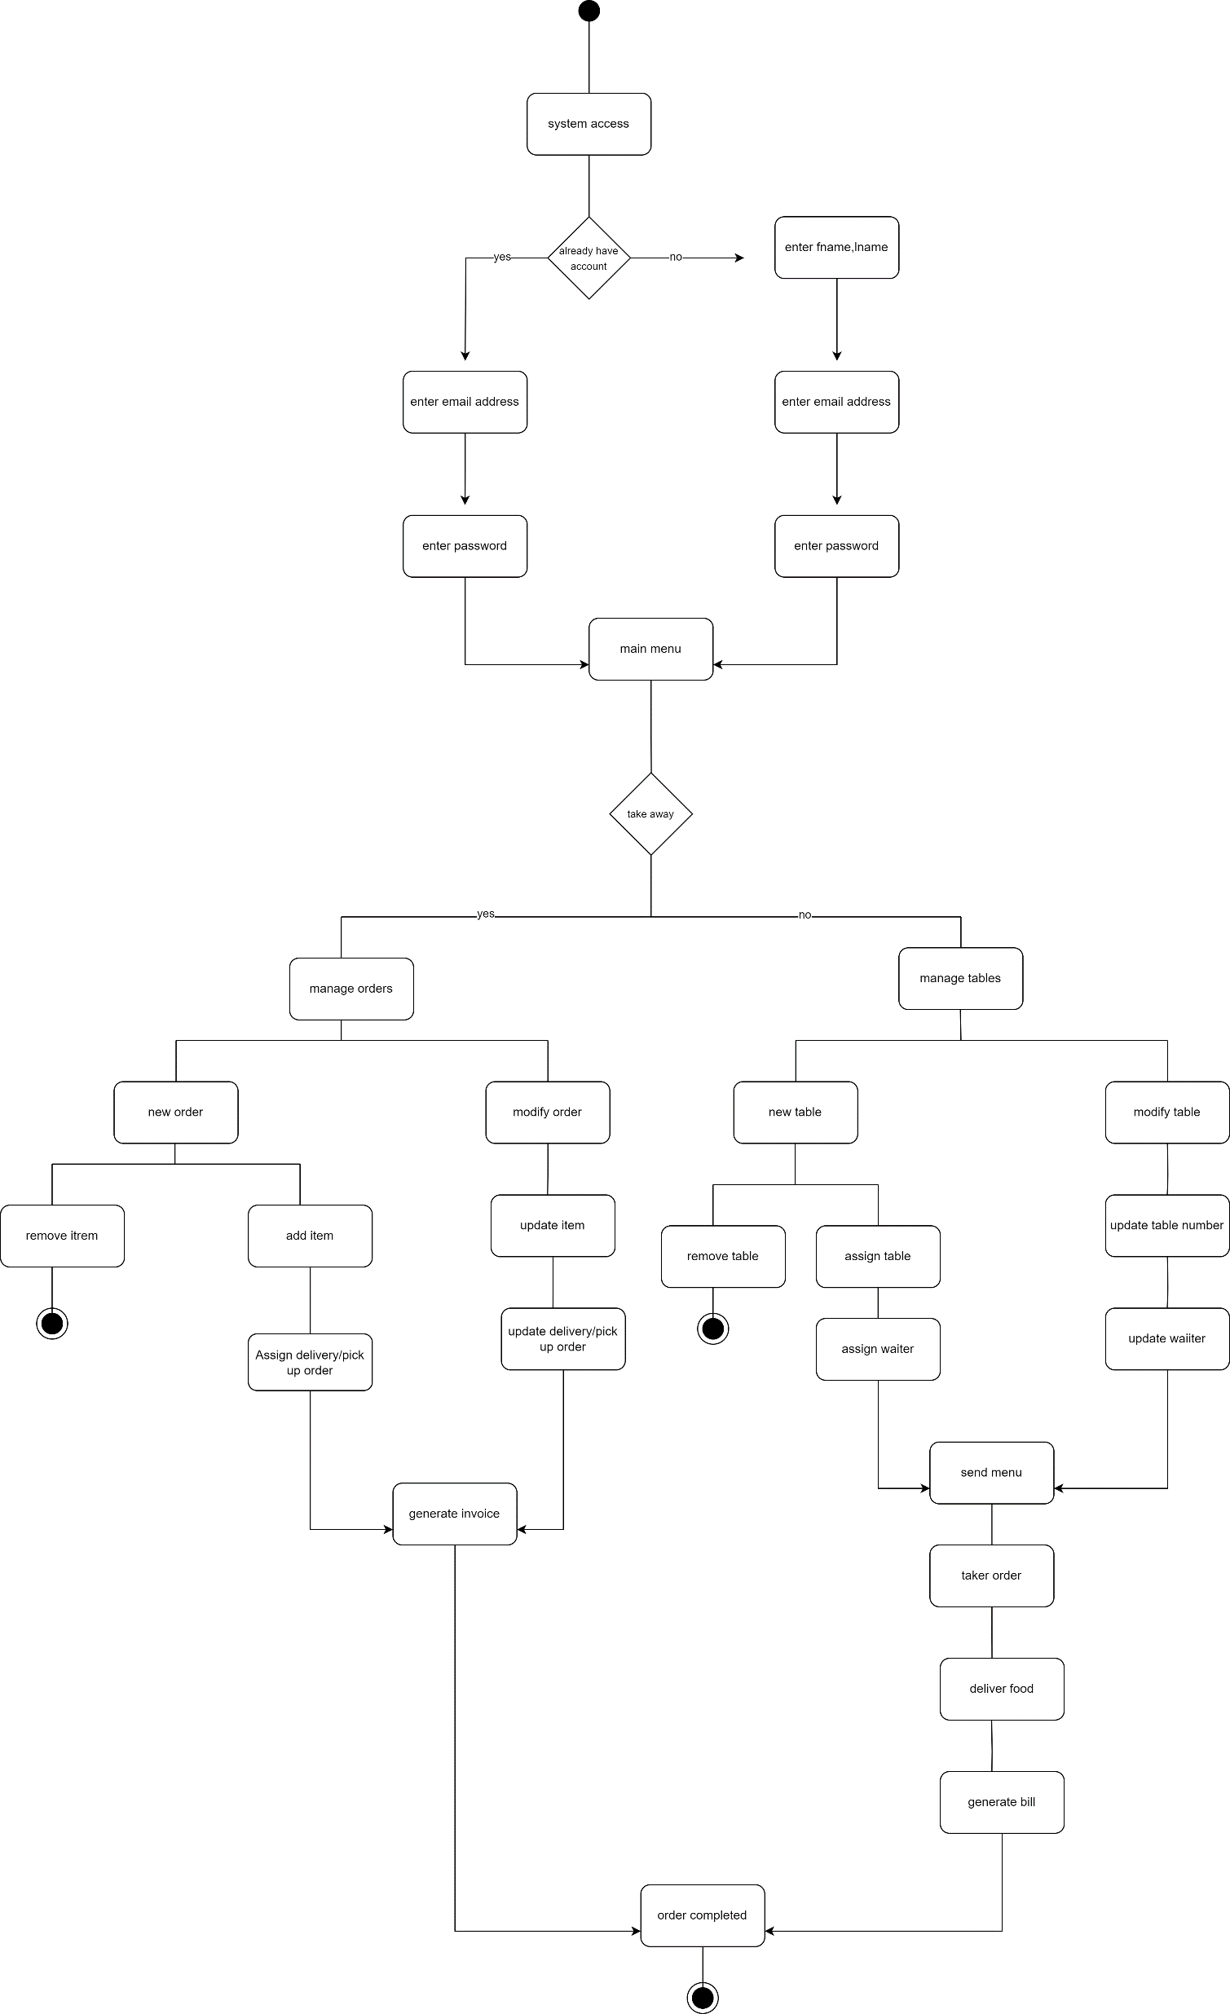
Activity Diagram

Slide 56
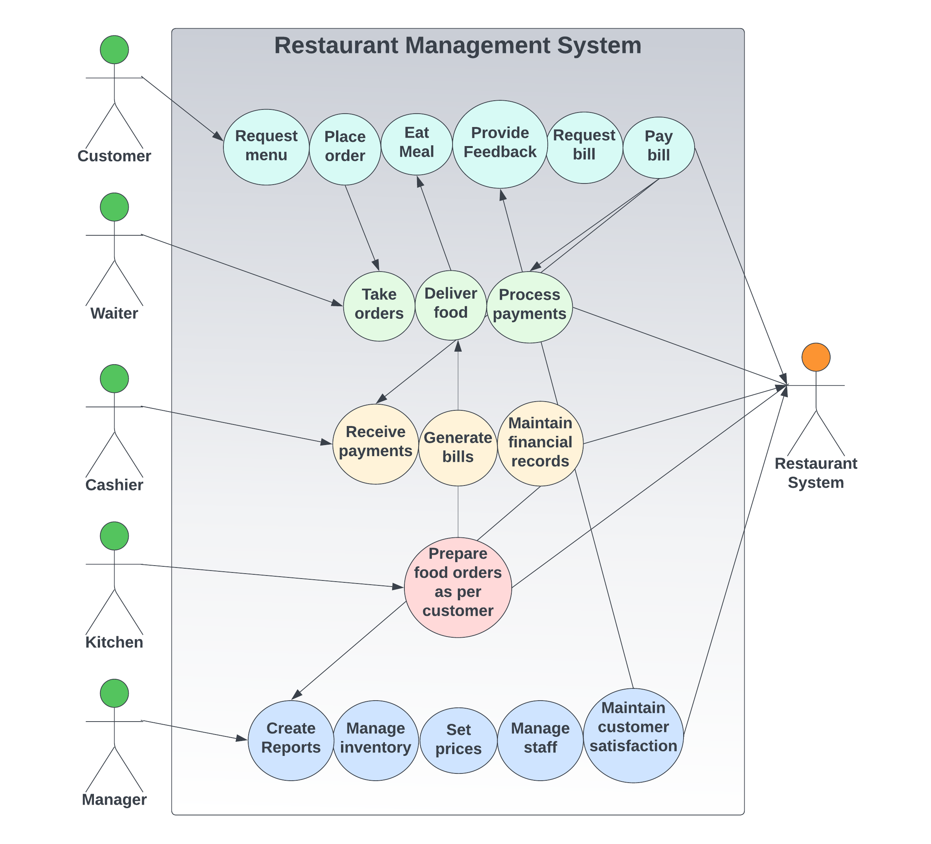
Use Case

Slide 57

Detailed Use case

Slide 58
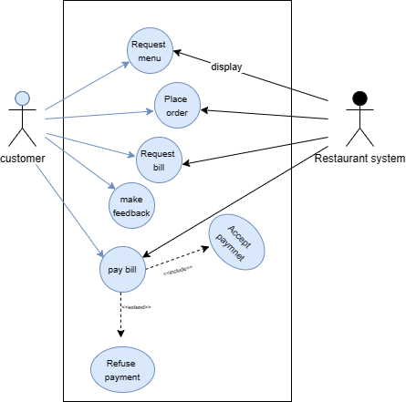
1. Customer

Slide 59
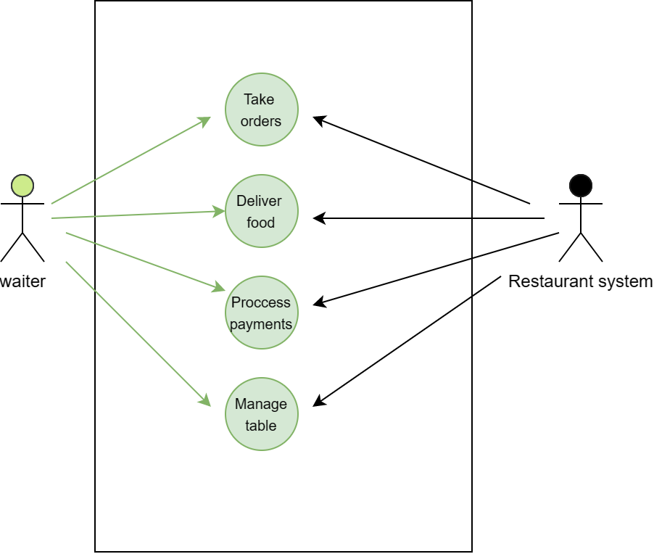
2. Waiter

Slide 60
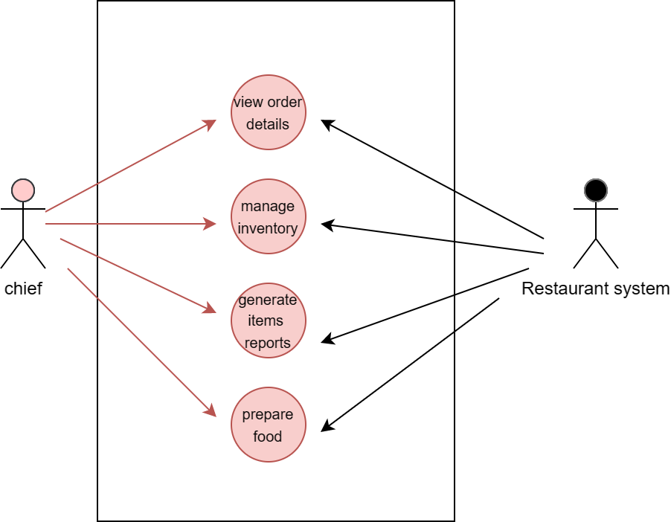
3. Chef

Slide 61
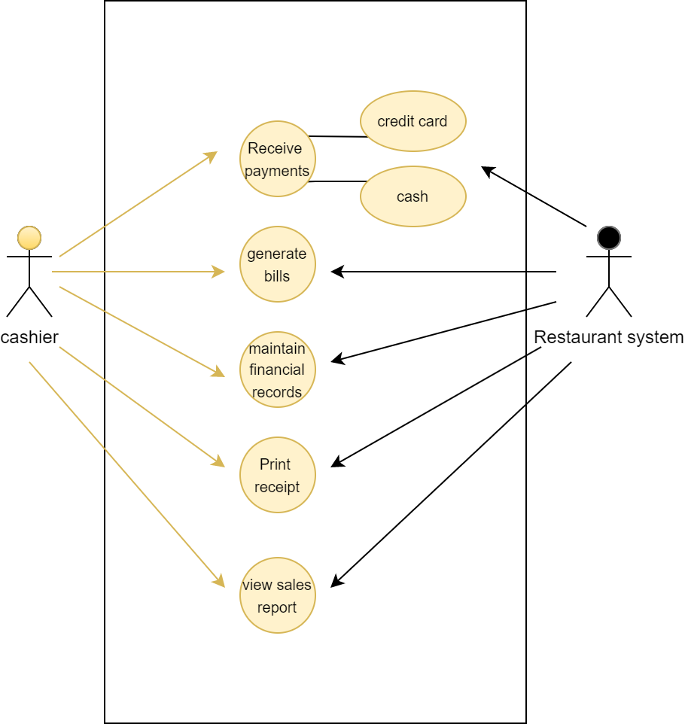
4. Cashier

Slide 62
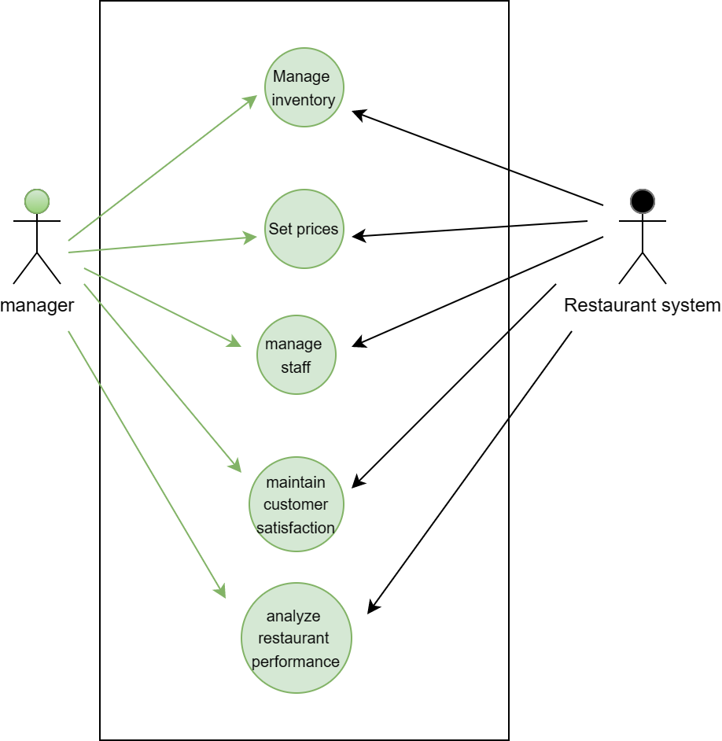
5. Manager

Slide 63






